Slide 1
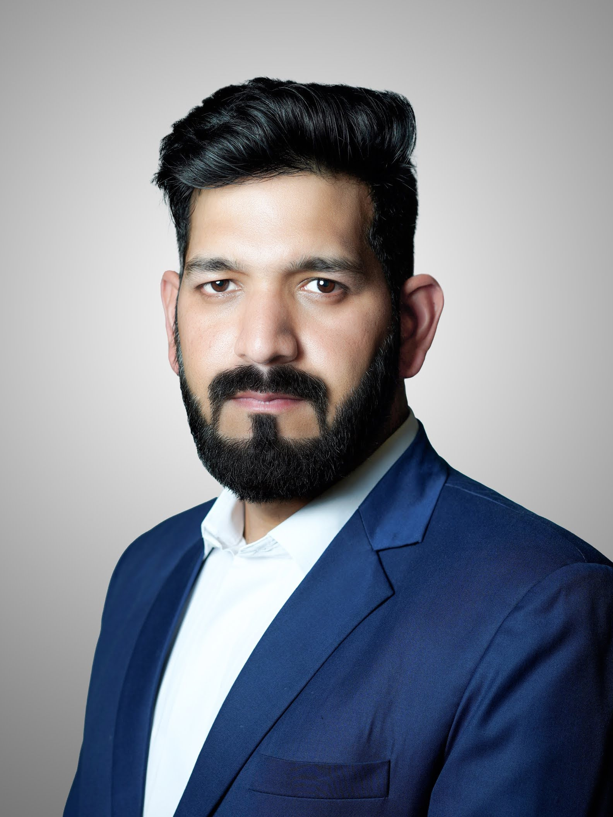
Vivek Singh
SAP MM Consultant
With over 14 years of professional experience, I possess a solid foundation in both domain expertise and a decade-long specialization in SAP. I am proficient in various SAP versions and have deep knowledge of Source to Pay domains such as Sourcing, Procurement and Inventory Management. My project execution skills shine through methodologies like ASAP and ACTIVATE, and I have successfully integrated SAP modules like Ariba, WM, PP, QM, SD, FI, and CO. Adapting to global projects and demonstrating strong analytical agility, I have led multiple implementations, upgrades, roll-outs, and support projects. My leadership and communication abilities have fostered collaborative environments, and I've made meaningful contributions beyond the professional sphere. As a Business Analyst and SAP Consultant, I've excelled in crafting tailored solutions from complex business scenarios, driving operational efficiency and organizational growth.

Slide 2
Highlights & Successes
Implementation Success: Led 6 end-to-end implementations, including high-profile projects like Etihad Rail and Toyota Kirloskar Motor, showcasing expertise in consulting, project management and delivery.
Strategic Expertise: Over 11+ years, adeptly collaborated with C-Level executives to define and execute impactful Enterprise technology strategies. Skillfully managed stakeholder relationships, ensuring alignment with organizational goals.
Process Optimization: Initiated and implemented process automation changes through review and revalidation projects, significantly enhancing the S2P function's efficiency and value.
Innovative Solutions: Generated impactful suggestions leading to the automation of crucial processes, delivering substantial value to the organization.
Collaborative Leadership: Held roles as EDGE and S2P lead, effectively deploying multiple solutions still in use today, highlighting enduring contributions to the organization.

Slide 3
Highlights & Successes
SAP Development Recognition: Received validation from SAP for 3 major developments, which were later integrated into the standard SAP suite, underlining technical prowess and innovation.
ERP System Transformation: Collaborated closely with a manufacturing company to architect an entirely new (Non SAP) ERP system, displaying a deep understanding of business needs and technology.
Project Management: Successfully managed several SAP projects and digital Transformation independently, demonstrating a strong sense of responsibility and project management capabilities. Excelled in reporting upwards, providing clear insights to stakeholders and ensuring transparency throughout the project lifecycle.
Integration Expertise: Thrived as an integration lead, showcasing a comprehensive grasp of seamless integration strategies for holistic system functionality. Highlights include integrating PO with PLM, harmonizing G Toppas collaboration, optimizing procurement through vendor colonization with SCP, and enhancing processes with CCMS for customer integration.

Slide 4
Value Proposition: Leveraging Past Experience
Business-Product Synergy: With experience as both a purchase team member and SAP consultant, I possess a unique perspective that bridges business operations and technical solutions, enabling me to comprehensively understand real-time problems and provide effective solutions.
Process Automation Expertise: With a proven track record of successfully executing automation projects, I am well-prepared to help Halcon in streamlining S2P processes such as sourcing, procurement, and inventory management. My experience extends to aiding in Industry 4.0 implementation, harnessing cutting-edge technologies to drive increased efficiency and minimize manual intervention, thus contributing to optimized operations and organizational growth.
Continuous Improvement Advocate: As a dedicated SAP expert who remains up-to-date with the latest advancements, I am poised to keep Halcon at the forefront of SAP's evolving landscape, facilitating the integration of valuable improvements into the organization's operations.
SAP Ariba Implementation: Recognizing the need for SAP Ariba, my experience with EDGE and SAP Ariba positions me to lead the implementation of this solution for strategic sourcing and process automation, aligning with Halcon's goals.
Seamless Integration Champion: My background as an integration lead enables me to facilitate the seamless integration of various SAP and non-SAP products, fostering unified processes and data flows across the organization.

